Slide 1

KISAN
EMPOWERING INDIA’S FARMERS

Slide 2
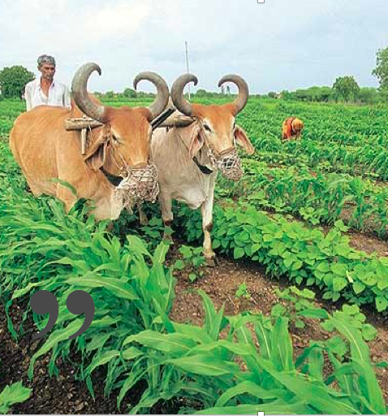
“
Hail the soldier! Hail the farmer!
“

Slide 3


Slide 4
56 % of the workforce

Slide 5
80% of the food

Slide 6


Slide 7


Slide 8
Tech Stack

Slide 9
People
TEAM
ALSO
Tanay Choudry
Haseeb Rabbani
Raiden
Ryan Angilly
Stephen Turex
Rajath Bhat

Slide 10
Presentation Design
This presentation uses the following typographies and colors:
Free Fonts used:
http://www.1001fonts.com/oswald-font.html
https://www.fontsquirrel.com/fonts/open-sans
Colors used

